Slide 1


Slide 2
Graphics Programming on the Web with WebCL
Mikaël Bourges-Sévenier, Motorola Mobility
August 9, 2012
Notes:
5 min. introduction to web programming for the complete novice. More resources available online – here we only introduce the technology necessary for following the rest of the course.

Slide 3
Over 32000 planks ;-) Blender/Bullet/SmallLuxGPU OpenCL
By Alain Ducharme “Phymec” http://www.youtube.com/watch?v=143k1fqPukk

Slide 4

Motivation
For compute intensive web applications
Games: physics, special effects
Computational photography
Scientific simulations
Augmented reality
…
Use many devices for general computations
CPU, GPU, DSP, FPGA…

Slide 5
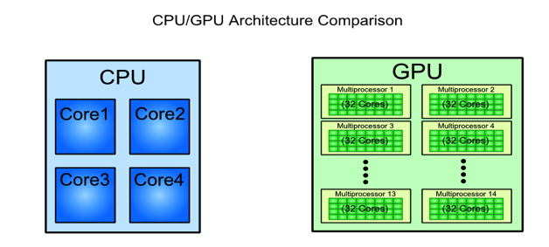
Motivation
GPUs provide exponential GFLOPS growth every year vs. CPUs
NVidia CUDA/OpenCL C programming guide

Slide 6


Content
Motivation and Goals
General-Purpose computations on GPU (GPGPU)
From to
The need for more general data-parallel computations
WebCL overview
A JavaScript API over OpenCL
OpenCL concepts
WebCL API
WebCL programming
Pure computations
WebGL interoperability

Slide 7
Content
Motivation and Goals
General-Purpose computations on GPU (GPGPU)
From to
The need for more general data-parallel computations
WebCL overview
A JavaScript API over OpenCL
OpenCL concepts
WebCL API
WebCL programming
Pure computations
WebGL interoperability

Slide 8

WebGL pipeline
Programmable vertex & fragment shaders

Slide 9
General Purpose computations on GPU
With clever mapping of algorithms to GL pipeline
Textures as data buffers
Texture coordinates as computational domain
Vertex coordinates as computational range
Vertex shaders
to start computations
scatter operations
Fragment shaders
for algorithms steps
gather operations
Scatter (write values)
Gather (read values)

Slide 10
GPGPU with GL limitations
Hard to map algorithms to graphics pipeline
Hard to do scatter operations
Shader instances can NOT directly communicate with one another
… GPGPU with GL is hack-ish
CL is made for GPGPU, not graphics

Slide 11
Content
Motivation and Goals
General-Purpose computations on GPU (GPGPU)
From to
The need for more general data-parallel computations
WebCL overview
A JavaScript API over OpenCL
OpenCL concepts
WebCL API
WebCL programming
Pure computations
WebGL interoperability

Slide 12
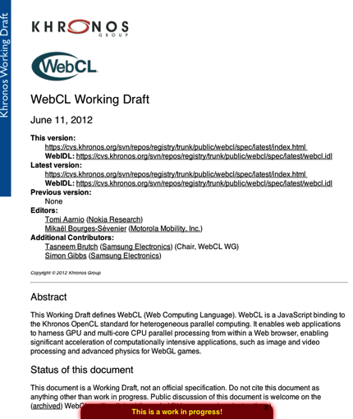

WebCL overview
WebCL brings parallel computing to the Web through a secure JavaScript binding to OpenCL 1.1 (2011)
Open standard, royalty-free
Platform independent
Device independent
being standardized by Khronos
First public working draft April 2012
http://www.khronos.org/webcl/

Slide 13
OpenCL overview
Features
C-based cross-platform API
Kernels use a subset of C99 and extensions
Vector extensions (<type>N)
No recursion, no function pointers
No dynamic memory (malloc, free…), no standard libc methods (memcpy…)
Well-defined numerical accuracy both for intergers and floats
Rich-set of built-in functions (e.g. as GLSL and more)
But no random method
Close to the hardware
Control over memory use
Control over thread scheduling

Slide 14

OpenCL Device Model
A host is connected to one or more Compute devices
Compute device
A collection of one or more compute units (~ cores)
A compute unit is composed of one or more processing elements (~ threads)
Processing elements execute code as SIMD or SPMD

Slide 15

OpenCL Execution Model
Kernel
Basic unit of executable code (~ DLL entry point)
Data-parallel or task-parallel
Program
Collection of kernels and functions called by kernels
Analogous to a dynamic library (DLL)
Command Queue
Control operations on OpenCL objects (memory transfers, kernels execution, synchronization)
Commands queued in order
Execution in-order or out-of-order
Applications may use multiple command-queues per device
Work-item
An execution of a kernel by a processing element (~ thread)
Work-group
A collection of work-items that execute on a single compute unit (~ core)
GPU
CPU
Context
Queue
Queue

Slide 16


OpenCL Work-group 2D analogy
Local
Global
# work-items = # pixels
# work-groups = # tiles
Work-group size = tileW * tileH
All threads in a workgroup run
synchronously

Slide 17
OpenCL Memory Model
On Host
CPU RAM
On Compute Device
Global memory = GPU RAM
Constant memory = cached global memory
Texture memory = cached global memory optimized for streaming reads
Local memory = high-speed memory shared among work-items of a work-group (~ L1 cache)
Private memory = registers of a work-item, very fast memory
Memory management is explicit
App must move data host ➞ global ➞ local and back

Slide 18
OpenCL Kernel
Defined on a N-dimensional computation domain
A kernel is executed at each point of the computation domain

Slide 19
WebCL API
Same OO model as OpenCL
with JS classes
WebCL is global object
Notes:
Same as OpenCL 1.1 object model but using JavaScript objects rather than C calls.

Slide 20
Content
Motivation and Goals
General-Purpose computations on GPU (GPGPU)
From to
The need for more general data-parallel computations
WebCL overview
A JavaScript API over OpenCL
OpenCL concepts
WebCL API
WebCL programming
Pure computations
WebGL interoperability

Slide 21
WebCL sequence (host side)
Create context
Compile kernels
Setup command-queues
Setup kernels arguments
Execute commands
Read results

Slide 22
WebCL sequence (host side)

Slide 23
WebCL sequence (host side)
Notes:
----- Meeting Notes (8/2/12 16:54) -----
kernels can come from anywhere

Slide 24
WebCL sequence (host side)

Slide 25
WebCL sequence (host side)

Slide 26
WebCL sequence (host side)
Note: Use local work size = [] or null (default) to let driver chose the best values.

Slide 27
WebCL sequence (host side)

Slide 28
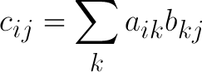
Example: Matrix multiplication
“Hello World of CL”
C = A x B
N x N matrices

Slide 29
Example: Matrix multiplication
Optimization
N x N matrices
C divided into m x m tiles
With
m = N / P
P = # threads per workgroup (16)

Slide 30
Example: Comparison with sequential
MacBook Pro (early 2011), OSX 10.8
CPU: Intel Core i7, 2.2GHz, 4 cores
GPU: AMD Radeon HD 6750M, 1 GB, 480 SPU, 600 MHz, 576 GFLOPS

Slide 31
WebCL / WebGL interop
WebCL context created from WebGL context
Configure shared CL objects from GL counterparts
Sync GL and CL
Flush GL, acquire GL object
Execute CL
Release CL object, flush CL
Vertex arrays, textures, render-buffers can be shared with CL
Notes:
----- Meeting Notes (8/2/12 16:54) -----
Vertex buffer objects

Slide 32
WebCL / WebGL interop

Slide 33
WebCL / WebGL interop (texture)

Slide 34
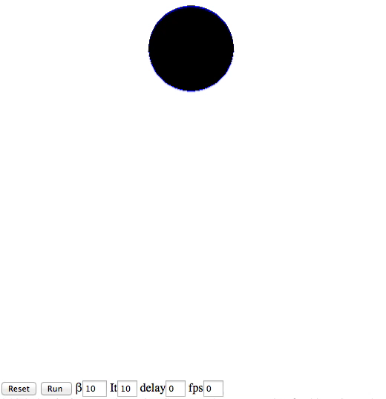
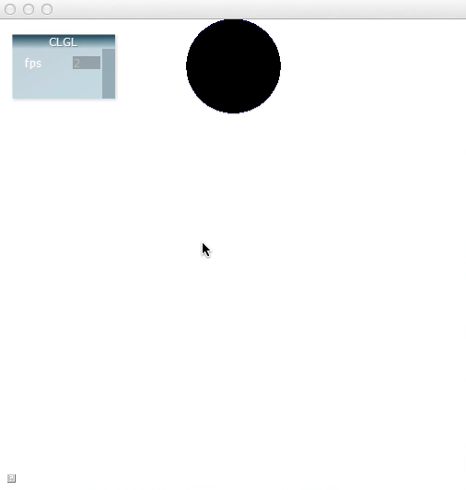
Demo: GL Texture update with CL
Based on Evgeny Demidov 2D ink droplet
WebGL ~26 fps
WebCL ~124 fps

Slide 35
WebCL / WebGL interop (vbo)

Slide 36
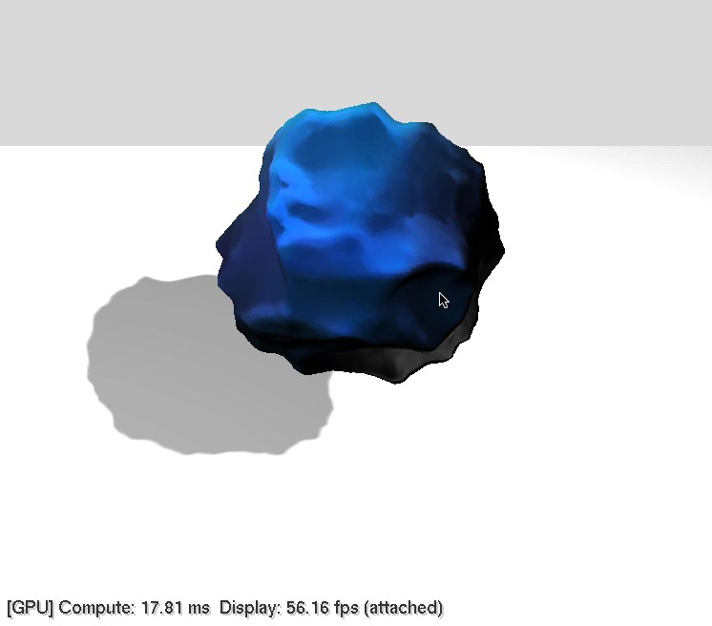
Demo: VBO update with CL

Slide 37
WebCL/WebGL interop (host side)

Slide 38
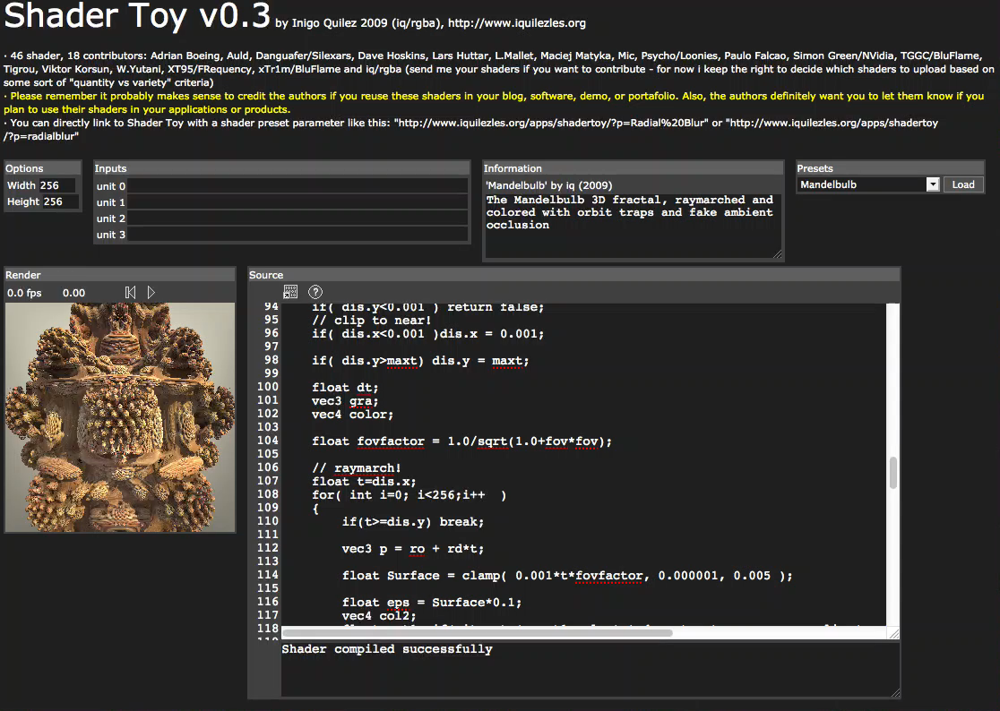
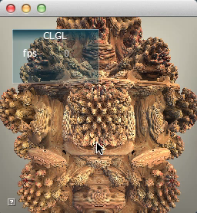
Demo: Texture update with CL
Based on Iñigo Quilez ShaderToy
WebGL ~6 fps
WebCL ~22 fps

Slide 39
Perspectives
WebCL enables GPGPU applications in Web browsers
Careful usage of architecture can lead to impressive speedup
With WebGL interoperability, rich graphics Web applications are now possible
DRAFT WebCL specification
Quite stable JavaScript API
Focusing on more security and robustness

Slide 40
WebCL Open process and Resources
Khronos open process to engage Web community
Public specification drafts, mailing lists, forums
http://www.khronos.org/webcl/
webcl_public@khronos.org
Nokia open source prototype for Firefox in May 2011 (LGPL)
http://webcl.nokiaresearch.com
Samsung open source prototype for WebKit in July 2011 (BSD)
http://code.google.com/p/webcl/
Motorola open source prototype for NodeJS in March 2012 (BSD)
https://github.com/Motorola-Mobility/node-webcl

Slide 42

This slide has a 16:9 media window

Slide 43




Start learning Now!
OpenCL Programming Guide - The “Red Book” of OpenCL
http://www.amazon.com/OpenCL-Programming-Guide-Aaftab-Munshi/dp/0321749642
OpenCL in Action
http://www.amazon.com/OpenCL-Action-Accelerate-Graphics-Computations/dp/1617290173/
Heterogeneous Computing with OpenCL
http://www.amazon.com/Heterogeneous-Computing-with-OpenCL-ebook/dp/B005JRHYUS
The OpenCL Programming Book
http://www.fixstars.com/en/opencl/book/

